Slide 1
Parkinson’s Ireland Assistive Technology Webinar
Juliann Bergin – jbergin@enableireland.ie
Mary Relihan – mrelihan@enableireland.ie
11th September 2024

Slide 2
Agenda
Welcome
What is Assistive Technology and Digital Assistive Technology
Inbuilt Accessibility feature in your phone
Typing and mouse usage
Speech Recognition
Reminders supports
Virtual Assistants and Smarthomes
Feedback Survey

Slide 3
What does AT mean to AT users?

Slide 4
What do we mean when we talk about Assistive Technology?

Slide 5
Definition of Assistive Technology
Any item or product whether acquired commercially, modified or customised that enhances the independence of individuals with disabilities.
(World Health Organisation and World Bank, 2011)

Slide 6
Definition of Assistive Technology – World Health Organization
Assistive technology - the application of organized knowledge and skills related to assistive products, including systems and services. Assistive products are any external product (including devices, equipment, instruments or software)…the primary purpose of which is to maintain or improve an individual’s functioning and independence, and thereby promote their well-being.
WHO 2020

Slide 7
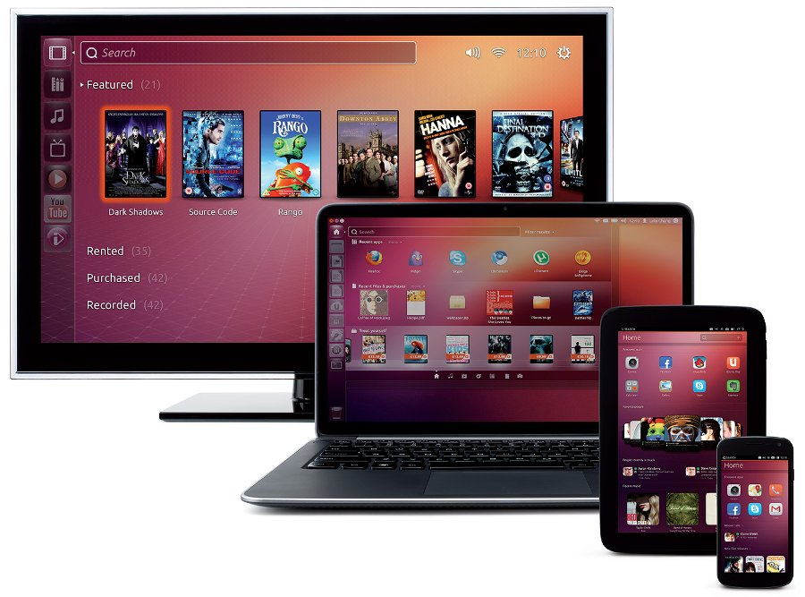
Digital Assistive Technology
Technologies and applications of ICTs that support persons with disabilities to live independently and fully participate in society. These include digital technologies that do not require a mobile phone as well as those that rely on mobile phones.
This Photo by Unknown Author is licensed under CC BY-NC

Slide 8
Who can benefit from Assistive Technology?
Anyone with a disability: preschool – adulthood
Students with dyslexia
Early school leavers
Ageing population
Employees
Prevent acquisition of work related injury
Retain staff who acquire injury
Anyone!

Slide 9
Technology trends
AT evolved from being a dedicated hardware to being software installed on a mainstream PC. With the adoption of Mobile Devices and app stores we saw a trend to making task specific apps rather than suites of tools. Other mainstream trends like wearable tech and smarthomes have also helped to make AT more mainstream and accessible to all.
Computer Based AT
All about the Apps
Wearable Tech
Smart Homes

Slide 10
Using Digital Devices

Slide 11
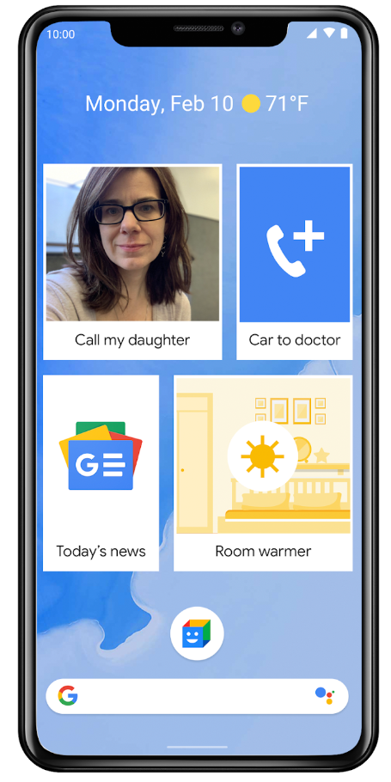
Phones
Android
Touch settings
Easy Mode – cleaner screen, larger icons, larger keyboard
Install “Big Launchers”
Action Blocks
iOS
Assistive Access
Touch Accommodations
Back Tap
Zoom View

Slide 12
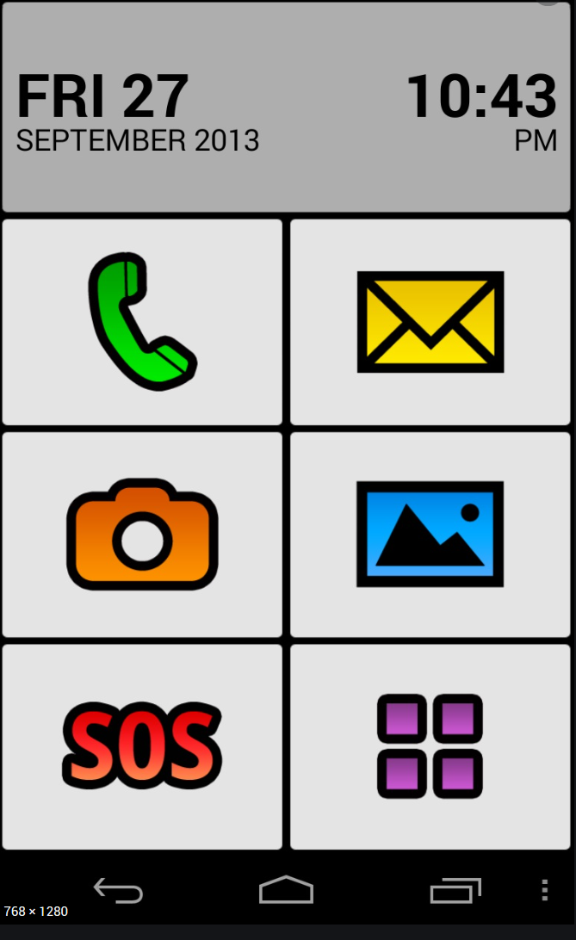
Larger button overlays - Android
Big Launcher
Simple Launcher
Simple Mode
Senior Safety Phone

Slide 13
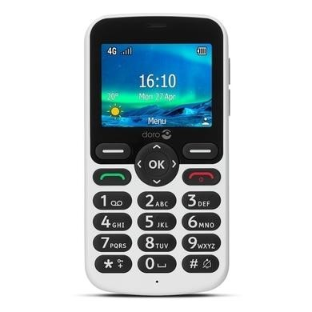
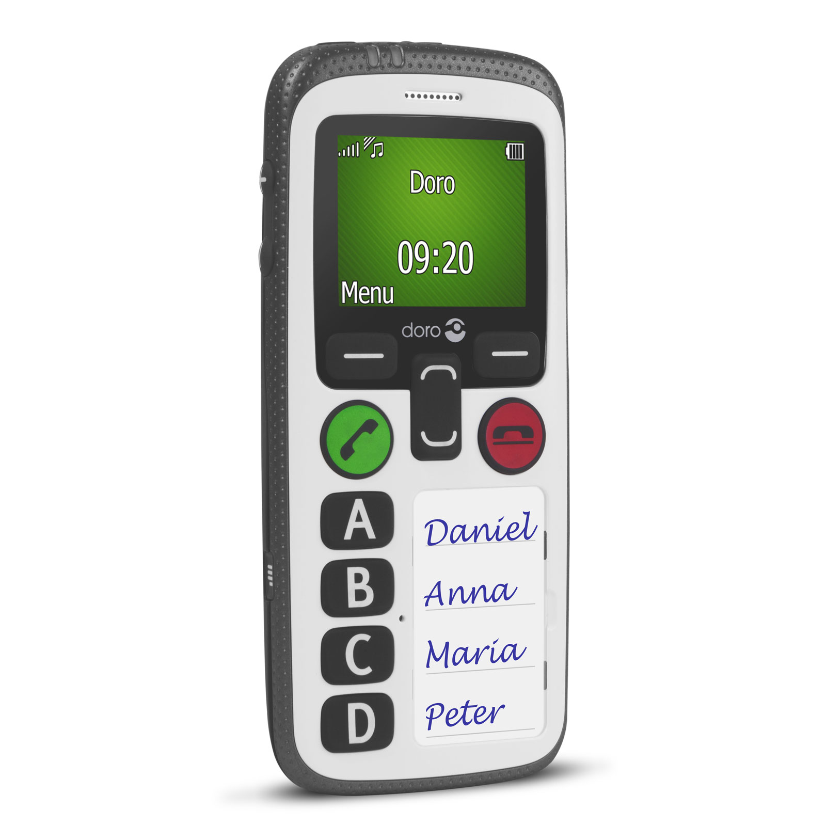
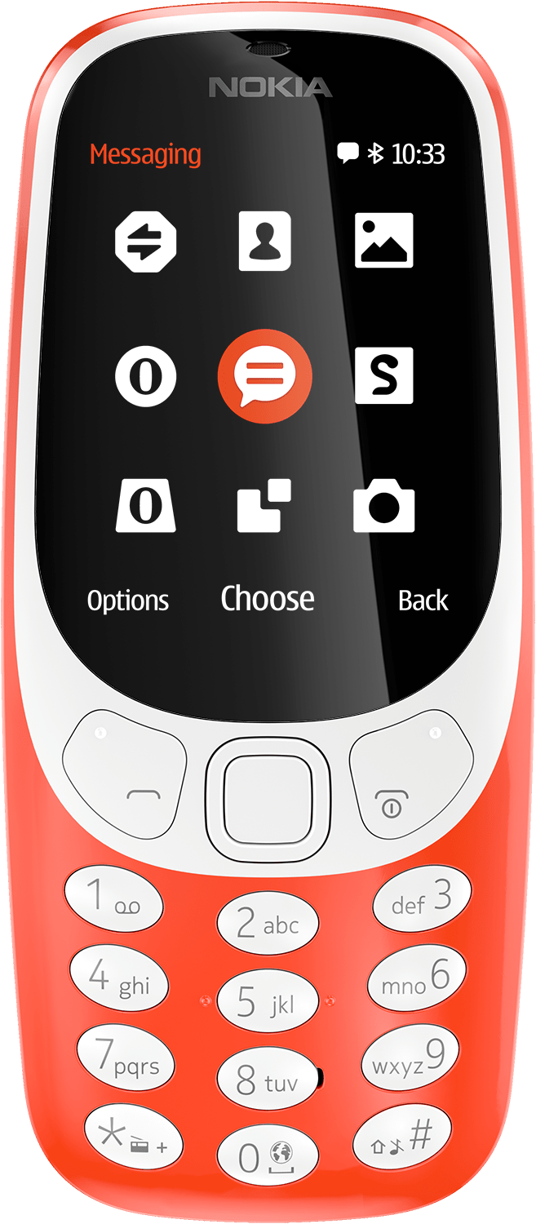
Non “Smart Phones”
KaiOS
E.g. Doro Phones
Button Hybrid Phones
E.g. Nokia 3310

Slide 14
On your computer or tablet

Slide 15
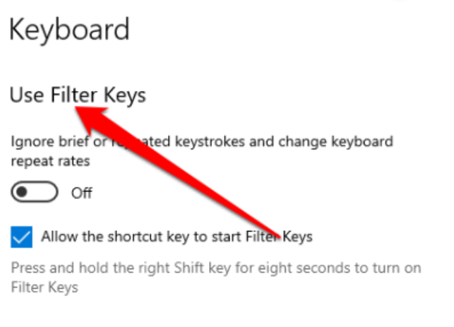
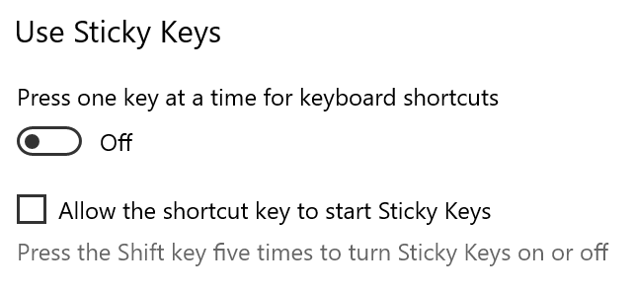
Typing
Filter/Slow keys
Ignore brief keystrokes
Slow down repeat rates
Sticky Keys
Sequential rather than concurrent key presses for shortcuts, capitals etc.

Slide 16
Keyboard Shortcuts
Use the keyboard when many use the Mouse
For menus – remember the underline rule
For dialogue boxes – TAB, SPACE, ENTER
For Buttons – ENTER, ESC, CURSORS
For Features – Look in Menus, Use HELP
For Windows:
http://windows.microsoft.com/en-ie/windows/keyboard-shortcuts
For Apple:
http://support.apple.com/kb/ht1343
For Android:
www.beginandroid.com/keyboard.shtml
For Linux
http://community.linuxmint.com/tutorial/view/45

Slide 17
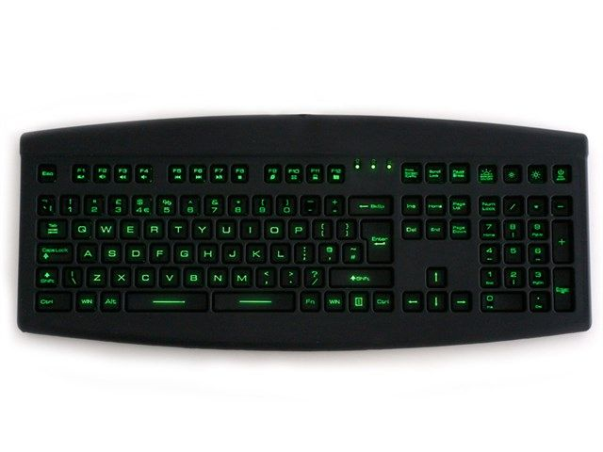
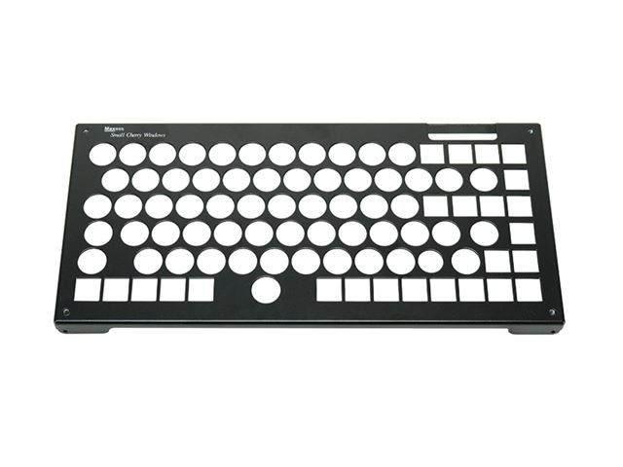
Hardware Options
Keyguards
Metal or plastic grid that sits over keys
Purchased with keyboard
Standard, compact or large variation
Springboard keyboard
Raised border around keys
Backlit
Antimicrobial surface
Designed by a person with a tremor

Slide 18
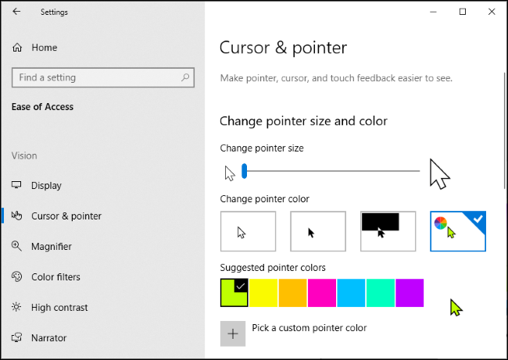
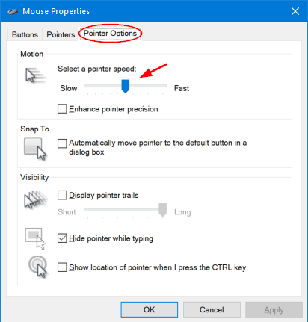
Mouse Cursor Adjustments
Increasing size of cursor
Changing cursor speed & buttons

Slide 19
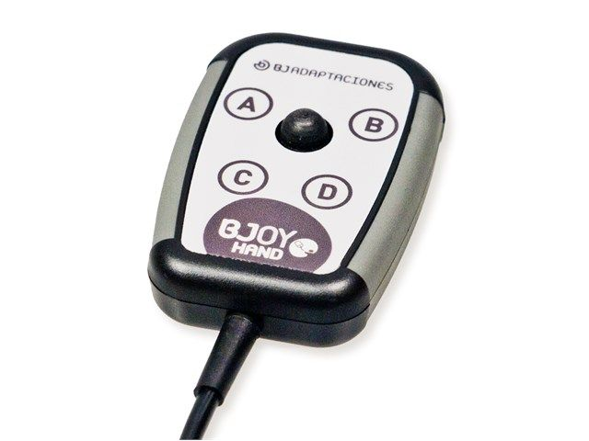
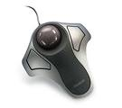
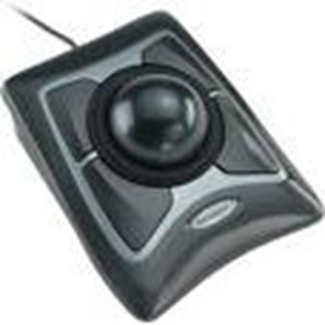
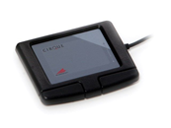
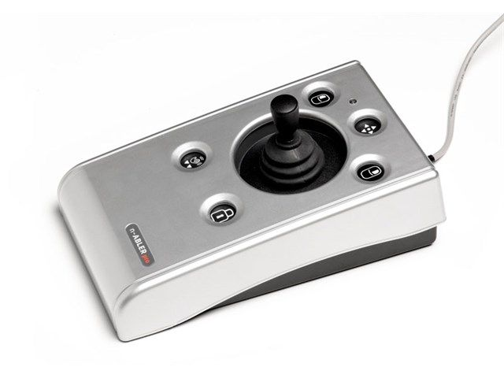
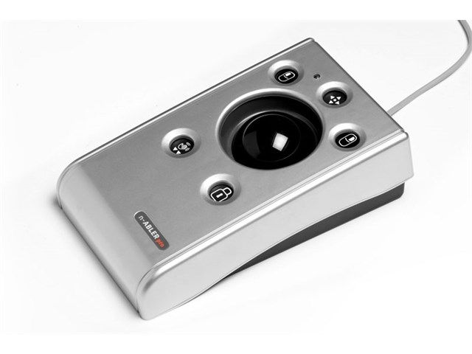
Alternative Types of Mice
Joystick
Touchpad
Rollerball mice

Slide 20
SteadyMouse Software

Slide 21
AMAneo BTI Mouse Adapter

Slide 22
Speech Recognition

Slide 23
Speech Recognition – What is it?
Differences between Dictation vs. Control
Capture speech using a microphone
Use algorithms to analyse sounds
Context and machine learning to determine words
Transcribe outcome on screen

Slide 24
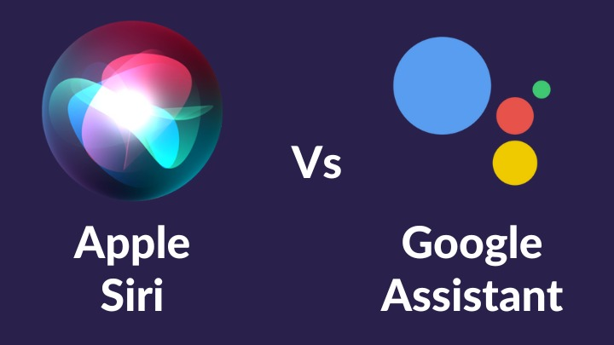
Types of Voice Recognition
Voice/virtual assistants on Phones and Tablets
Siri (callscotland.org.uk)
Android (callscotland.org.uk)
Voice assistants – stand alone:
Alexa
Google Home/Nest
Apple HomePod
This Photo by Unknown Author is licensed under CC BY-NC

Slide 25
Computer-Based Speech Recognition
Computer based
Google Voice Typing
Dictate in office 365
Dragon Naturally Speaking
Dragon Anywhere

Slide 26
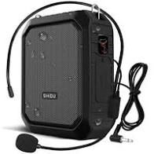
Voice - Amplification
Voice amplifier
Standalone
Purpose made
Different price points
Amplification apps
Loud and Clear (iOS and Android) – exercises to work on regulating volume
Multiple amplifier apps, that use your phone as a microphone with a Bluetooth speaker e.g.
Megaphone: Voice Amplifier
Microphone Amplifier

Slide 27
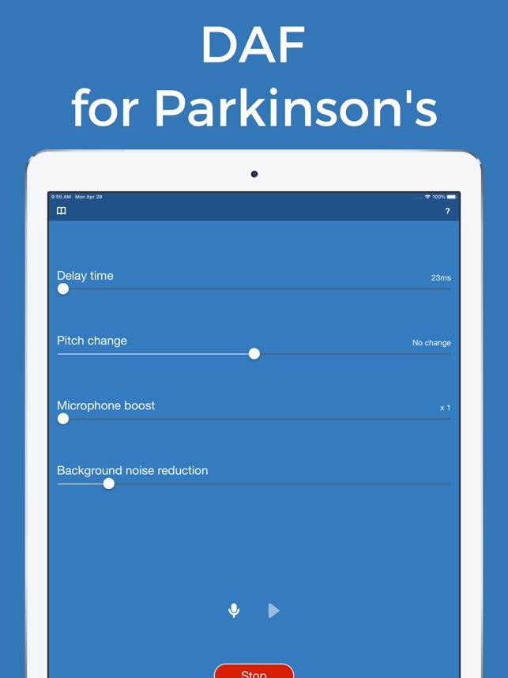
Voice Rate and Monitoring
Conversation Paceboard iOS
Speech Pacesetter iOS
Speaker Coach in MS Teams
Teleatherapy
DAF Pro iOS, Android

Slide 28
Reminders and Organisation

Slide 29
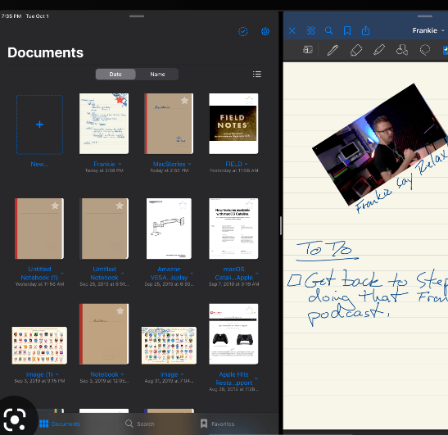
Reminders: Options
Use phone alarms/calendars
Can insert using Voice Assistant
Name alarms
Use inbuilt note apps – Notes, Google Keep
Download apps i.e. GoodNotes

Slide 30
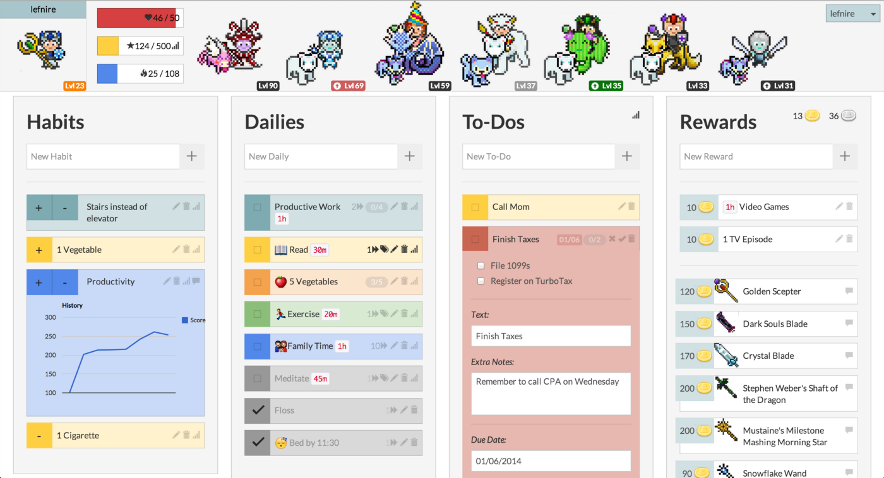
Checklists/Notes
Its Done
Habitica
Trello
ToDoist
Any.Do
Routinery
OneNote/EverNote

Slide 31
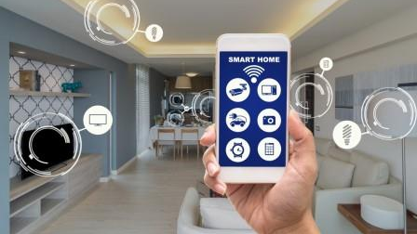
SmartHome Technologies
This Photo by Unknown Author is licensed under CC BY-SA-NC

Slide 32
Smart homes – What can you control?

Slide 33
Example of a Smarthome

Slide 34
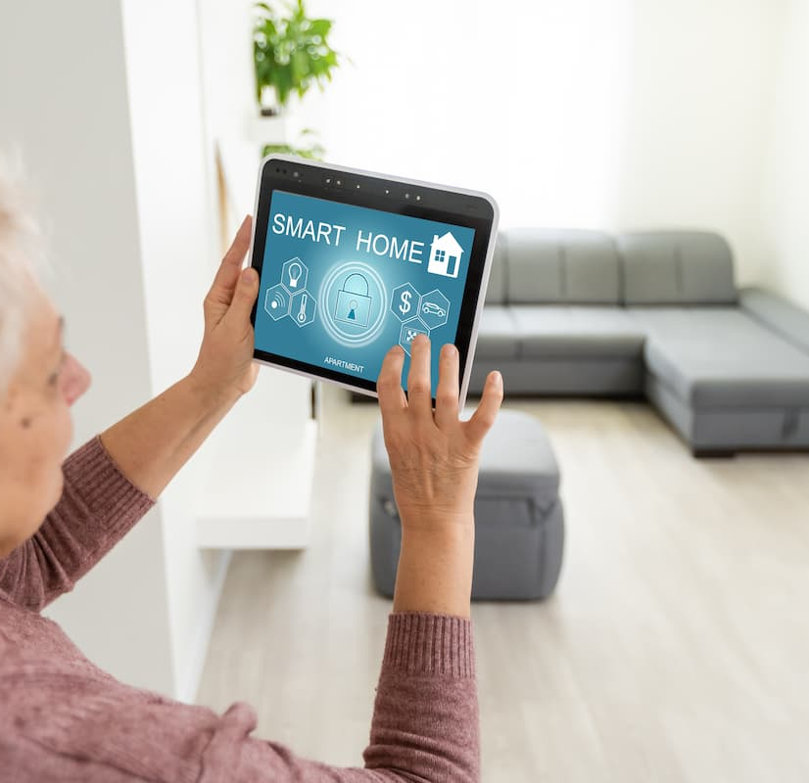
What does Independent Living mean?
Independent Living: Wellbeing & Self –Esteem
Autonomy
Privacy – time alone
Changed relationships
Independence
Part of a community

Slide 35
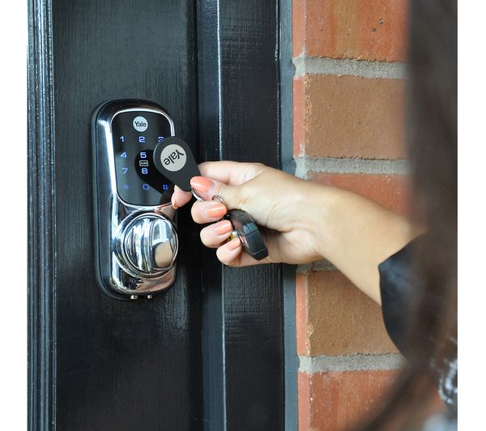
Home security
Door/lock openers
Intercoms
Video doorbells

Slide 36
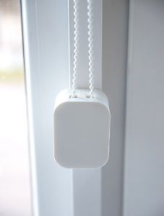
Light and ventilation
Window openers
Blind/curtain openers
Light controls

Slide 37
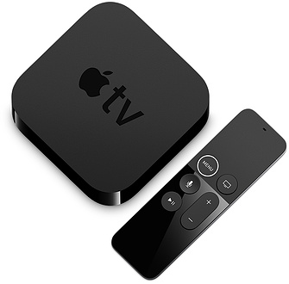
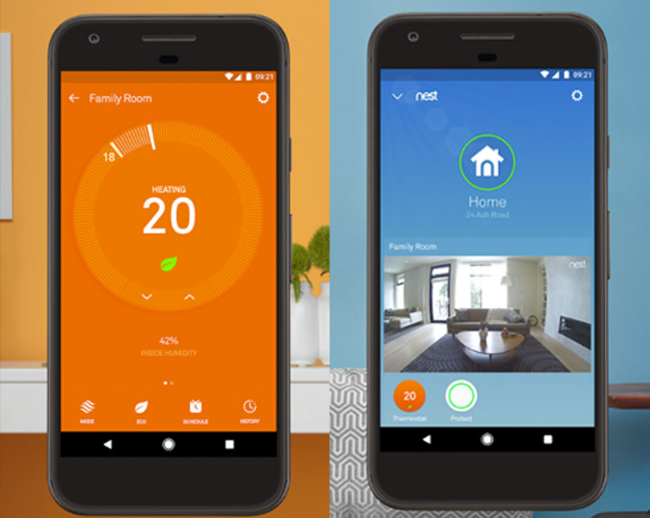
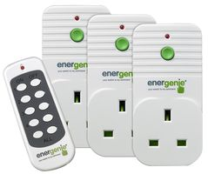
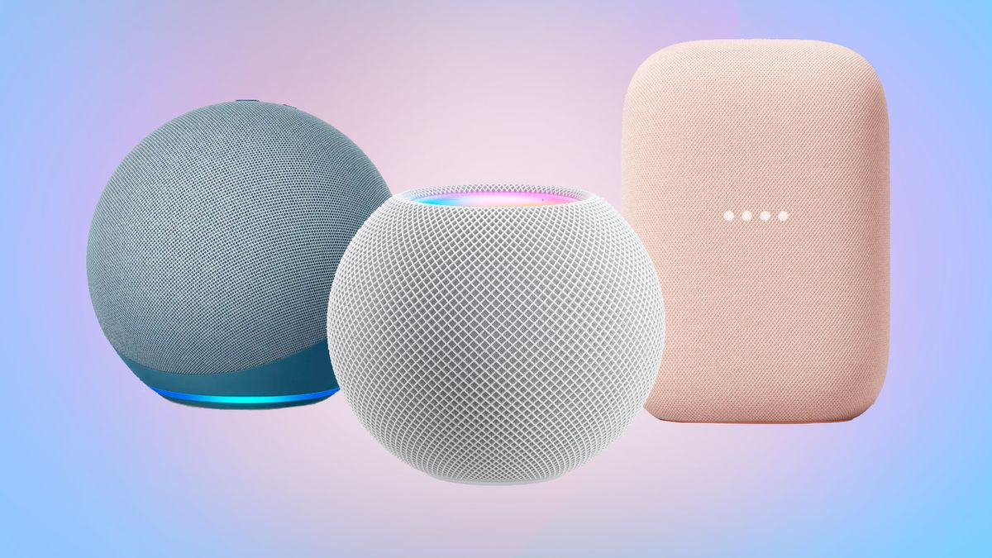
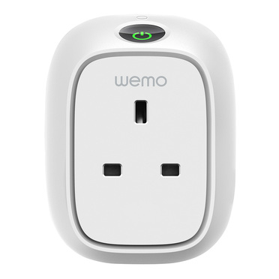
Appliance controls
Heating controls
Appliance controls
Entertainment controls

Slide 38
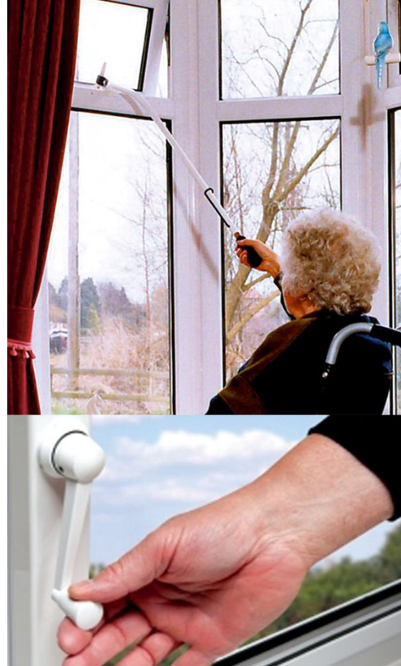
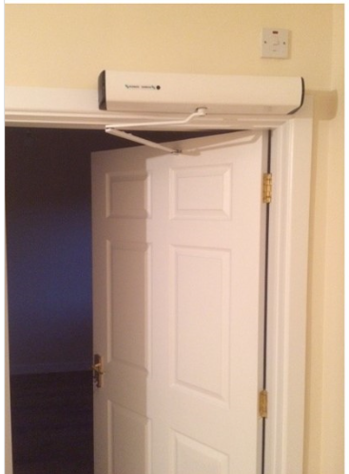
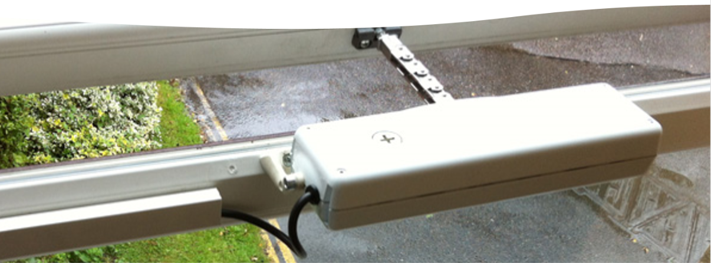
More Traditional Environmental controls

Slide 39
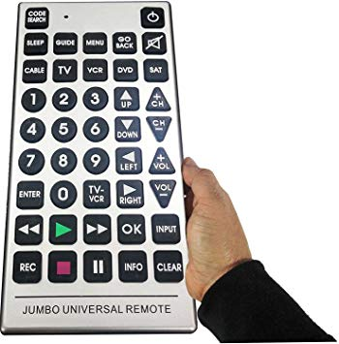
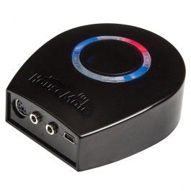
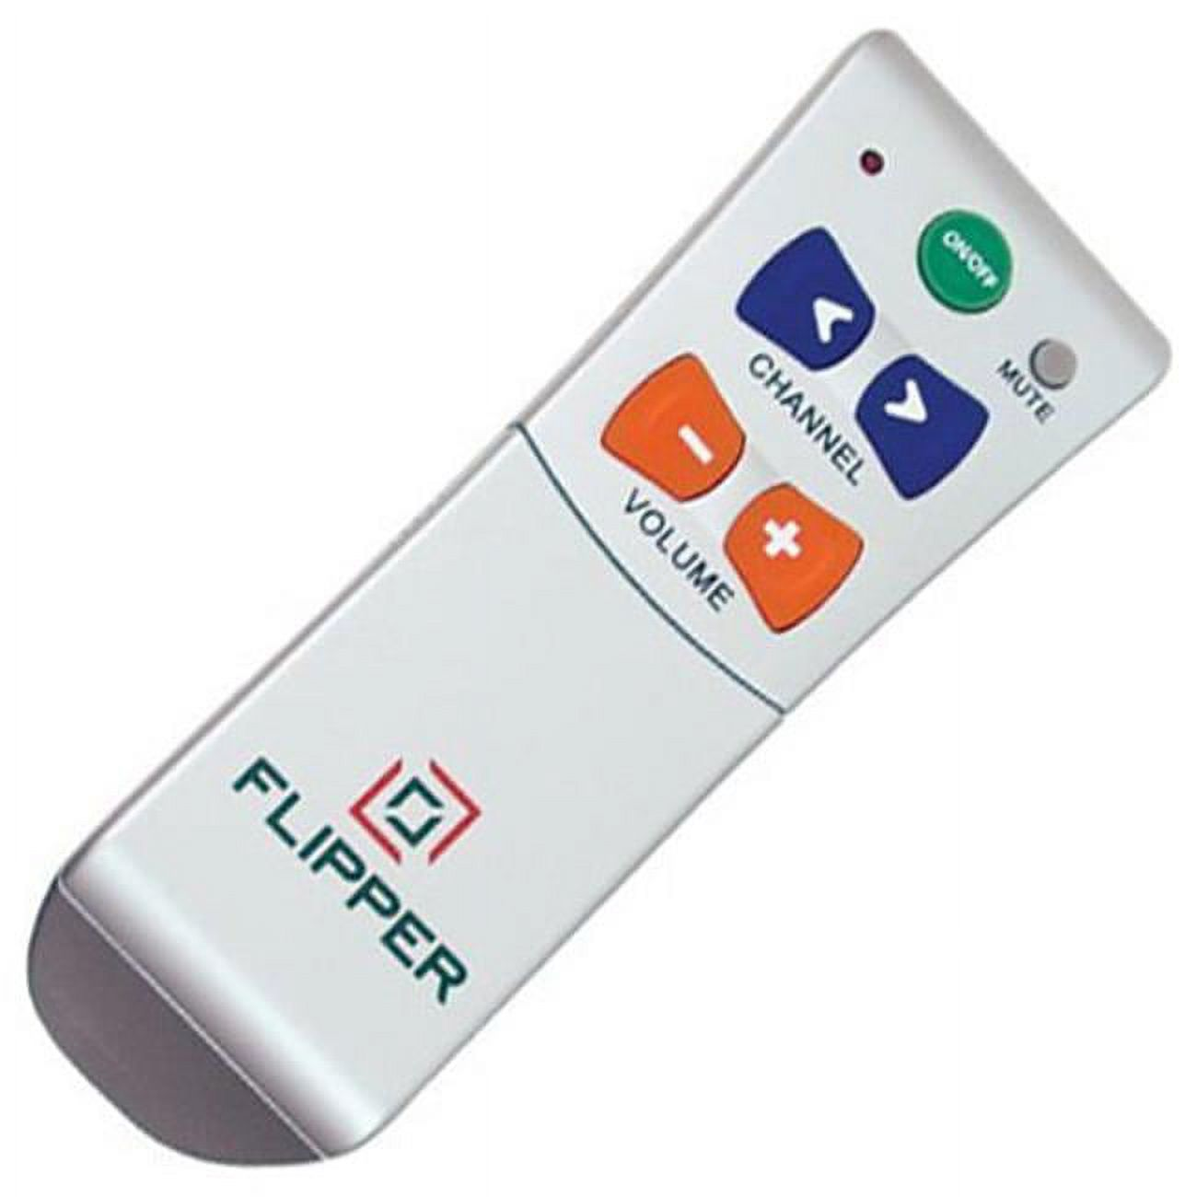
Entertainment controls

Slide 40
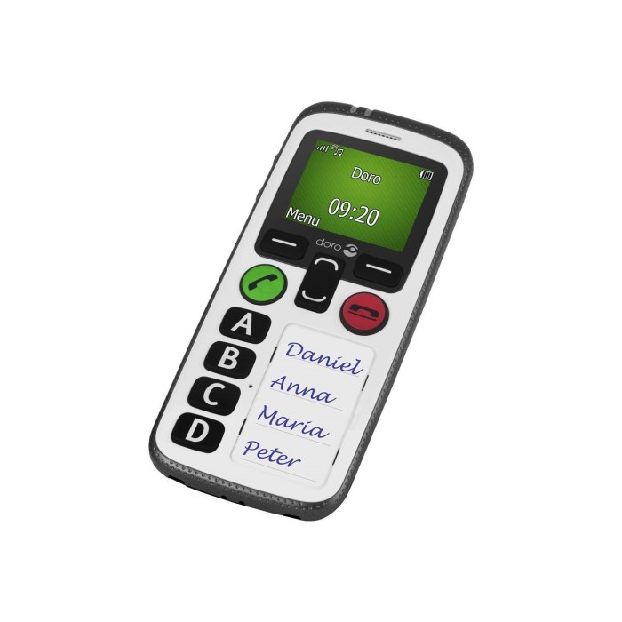
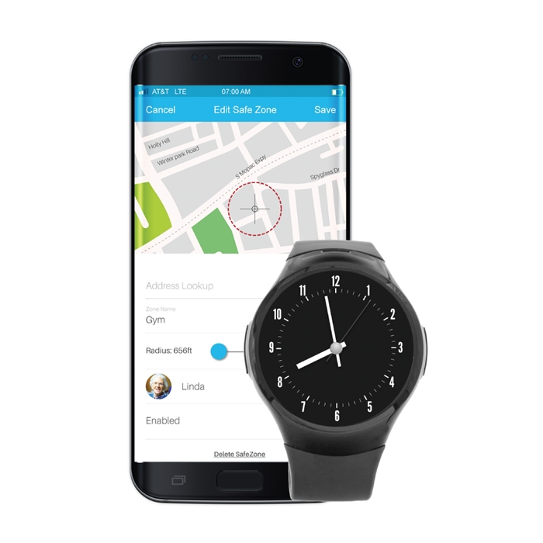
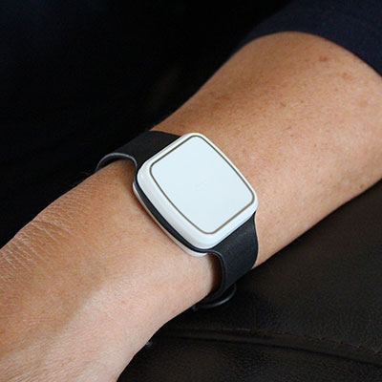
Safety while out and about
GPS inbuilt into phones,
SOS buttons
Fall detectors
Money management – i.e. Seeing AI

Slide 41
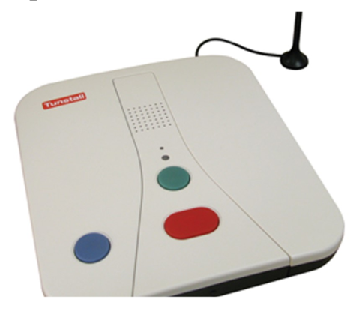
Traditional monitoring systems
Pendant Alarm
A pendent to activate the alarm is worn around the neck or wrist.
When the pendent alarm is activated in an emergency, it dials a 24 hour monitoring centre or up to 5 pre-assigned numbers, connecting the user to support.
Help by assessing the situation and contacting the necessary contact or emergency services to assist.

Slide 42
For further connection: enableireland.ie/at enableirelandat.ie: range of e learning courses: free, paid, accredited Atandme.com Freedomtech.ie @atandme @freedomtech_irl youtube.com/enableirelandat

Slide 43
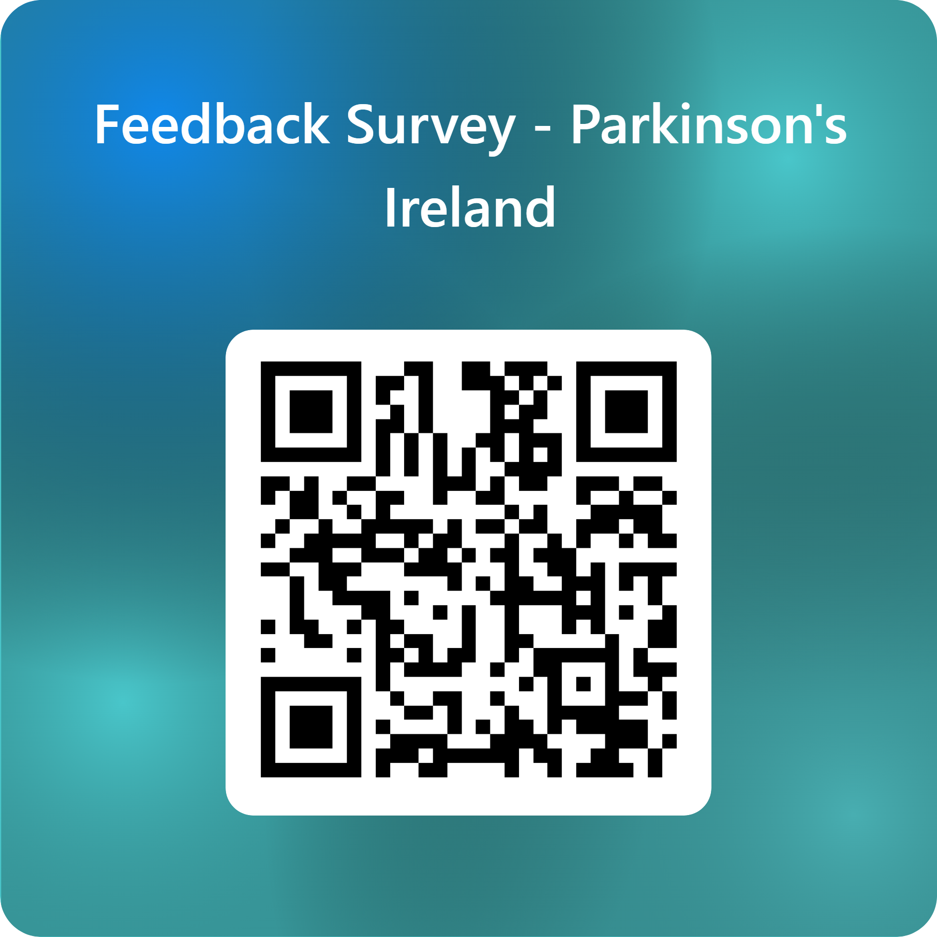
Please complete our feedback survey at the link below:
Parkinson’s Ireland Feedback Survey

